Slide 1

WEYLAND ENERGY
Grid & Permits – Q3 2026
Quarterly review · 1 October 2026

Slide 2
Q3 at a glance
4
26
1
34 h
grid agreements / applications
permits tracked
Harrow Bay requirement pending
KR curtailment Q3
WEYLAND ENERGY · Grid & Permits – Q3 2026 Review
2

Slide 3
Harrow Bay – energisation
• Stage 1 (240 MW) on 1 Sept 2027 – on track
• Export cable 2 energisation now 25 Jan 2028 (HB-RISK-017)
• Full TEC 31 Mar 2028 still achievable
• Req. 10 resubmitted 21 Sept
WEYLAND ENERGY · Grid & Permits – Q3 2026 Review
3

Slide 4
Millbrook – planning
• MDC/2026/0412: Highways holding objection withdrawn 24 Sept
• Natural England, EA, LLFA: no objection
• Amendment pack due 16 Oct
• Grid date 31 Oct 2028 – needs consent by Mar 2027
WEYLAND ENERGY · Grid & Permits – Q3 2026 Review
4

Slide 5
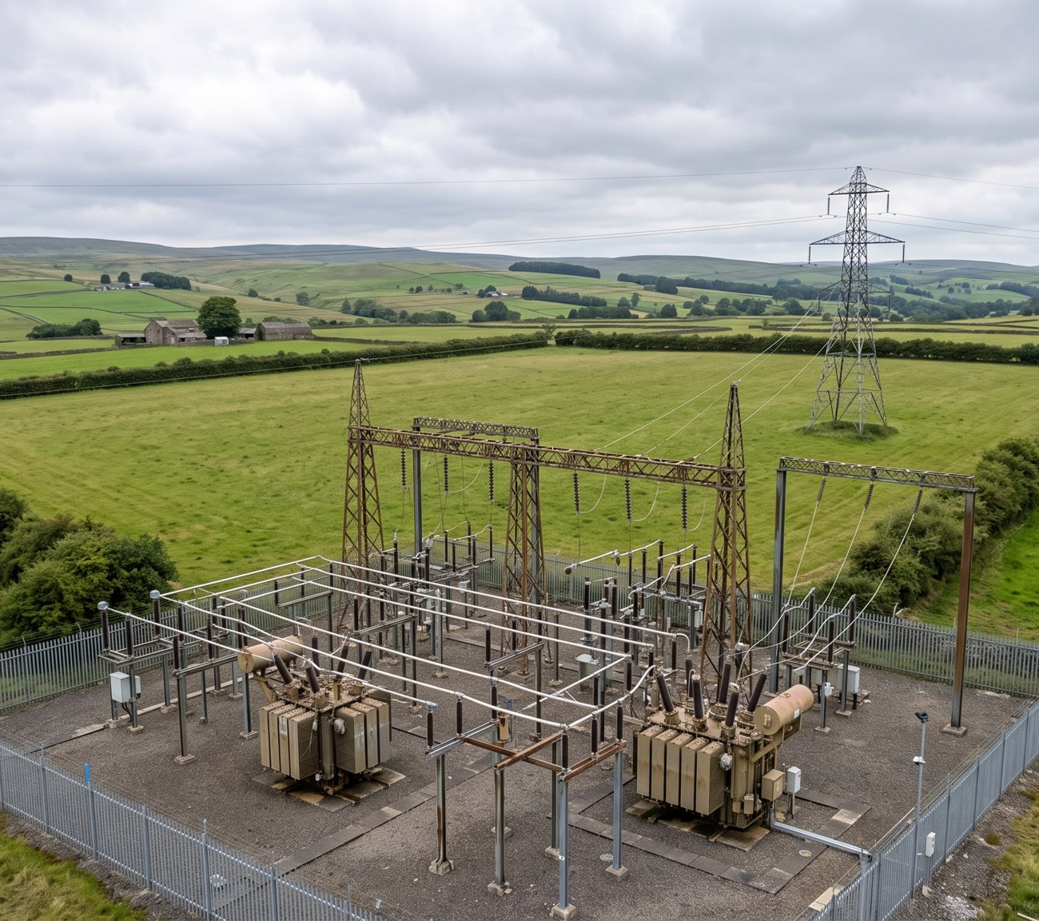
Fenwick – grid application
• NGT-APP-2026-0739 submitted 15 July, competent 21 Aug
• Gate 2 evidence due 30 Nov
• Load flow: constraints at peak wind until 2030
• Offer expected Q2 2027
WEYLAND ENERGY · Grid & Permits – Q3 2026 Review
5

Slide 6
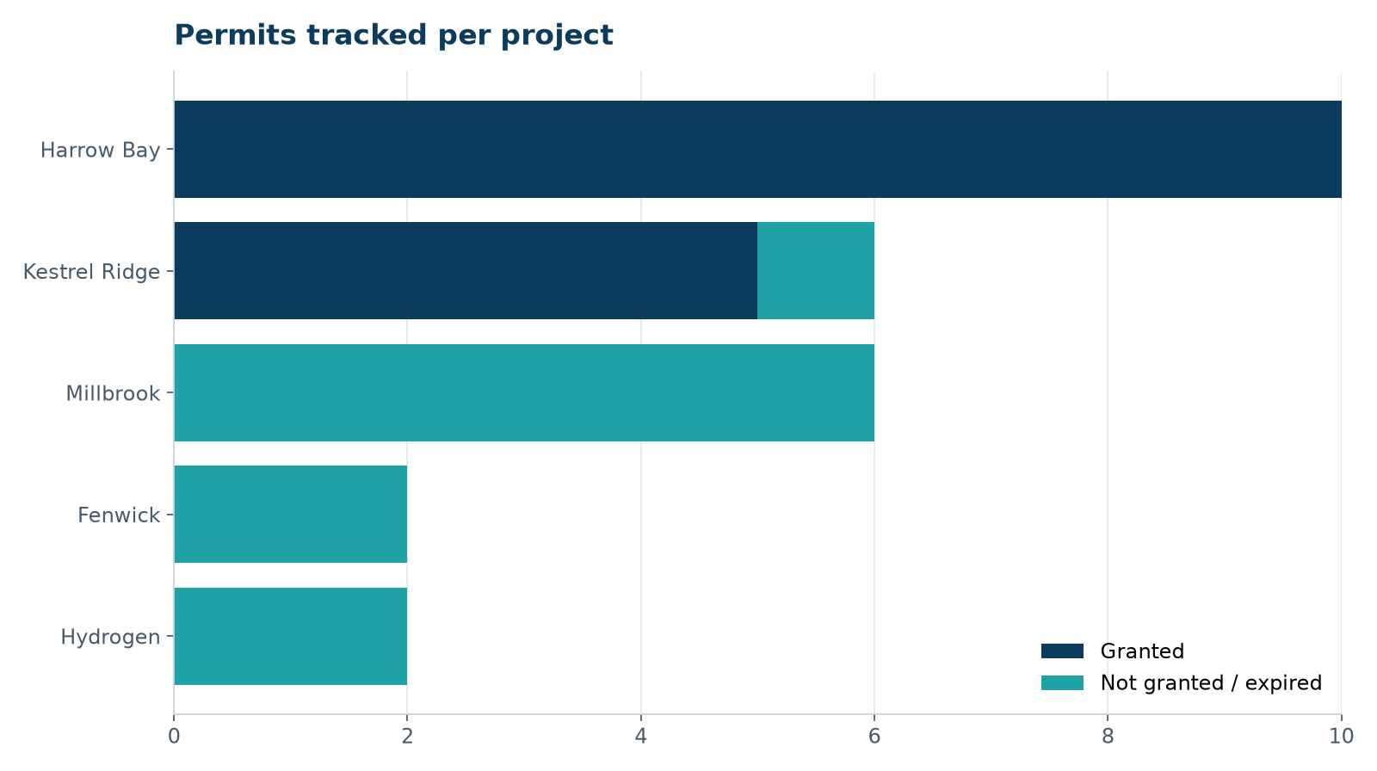
Permit status
• All Harrow Bay construction permits in place
• EPS licence (porpoise) renewal must start Jan 2027
WEYLAND ENERGY · Grid & Permits – Q3 2026 Review
6

Slide 7
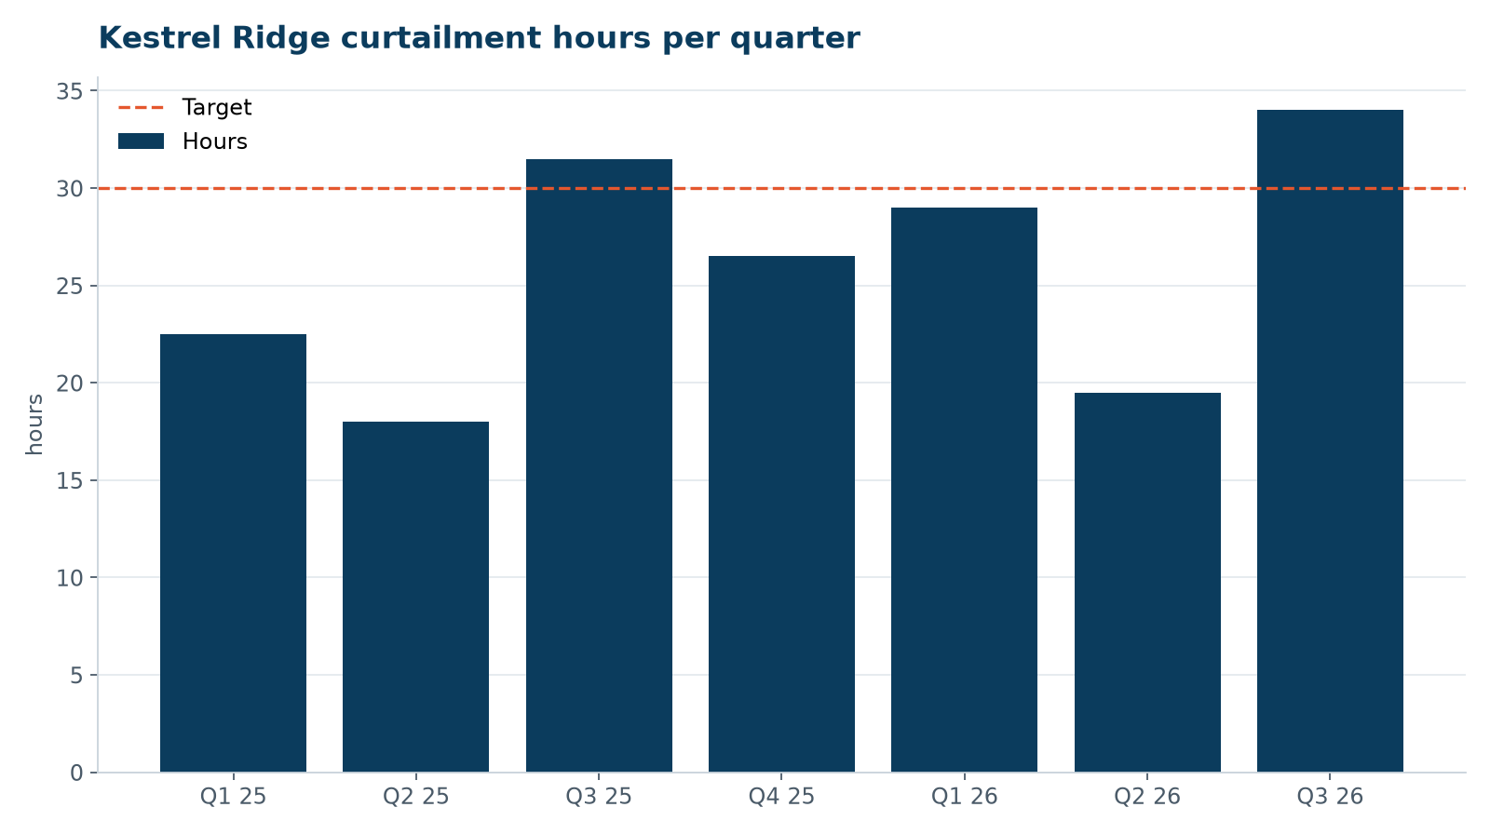
Kestrel Ridge curtailment
• Above 120 h/yr threshold → compensated
• Driven by Borders 132 kV ring thermal limits
WEYLAND ENERGY · Grid & Permits – Q3 2026 Review
7
Notes:
David asked whether we should push NordGrid on the ring reinforcement – suggest raising at the Q4 customer forum.

Slide 8
Asks to the board
• Note Gate 2 strategy for Fenwick
• Approve EUR 1.4 m Millbrook security step-up at consent
• Support response on NordGrid charging review (Q4)
WEYLAND ENERGY · Grid & Permits – Q3 2026 Review
8

Slide 9
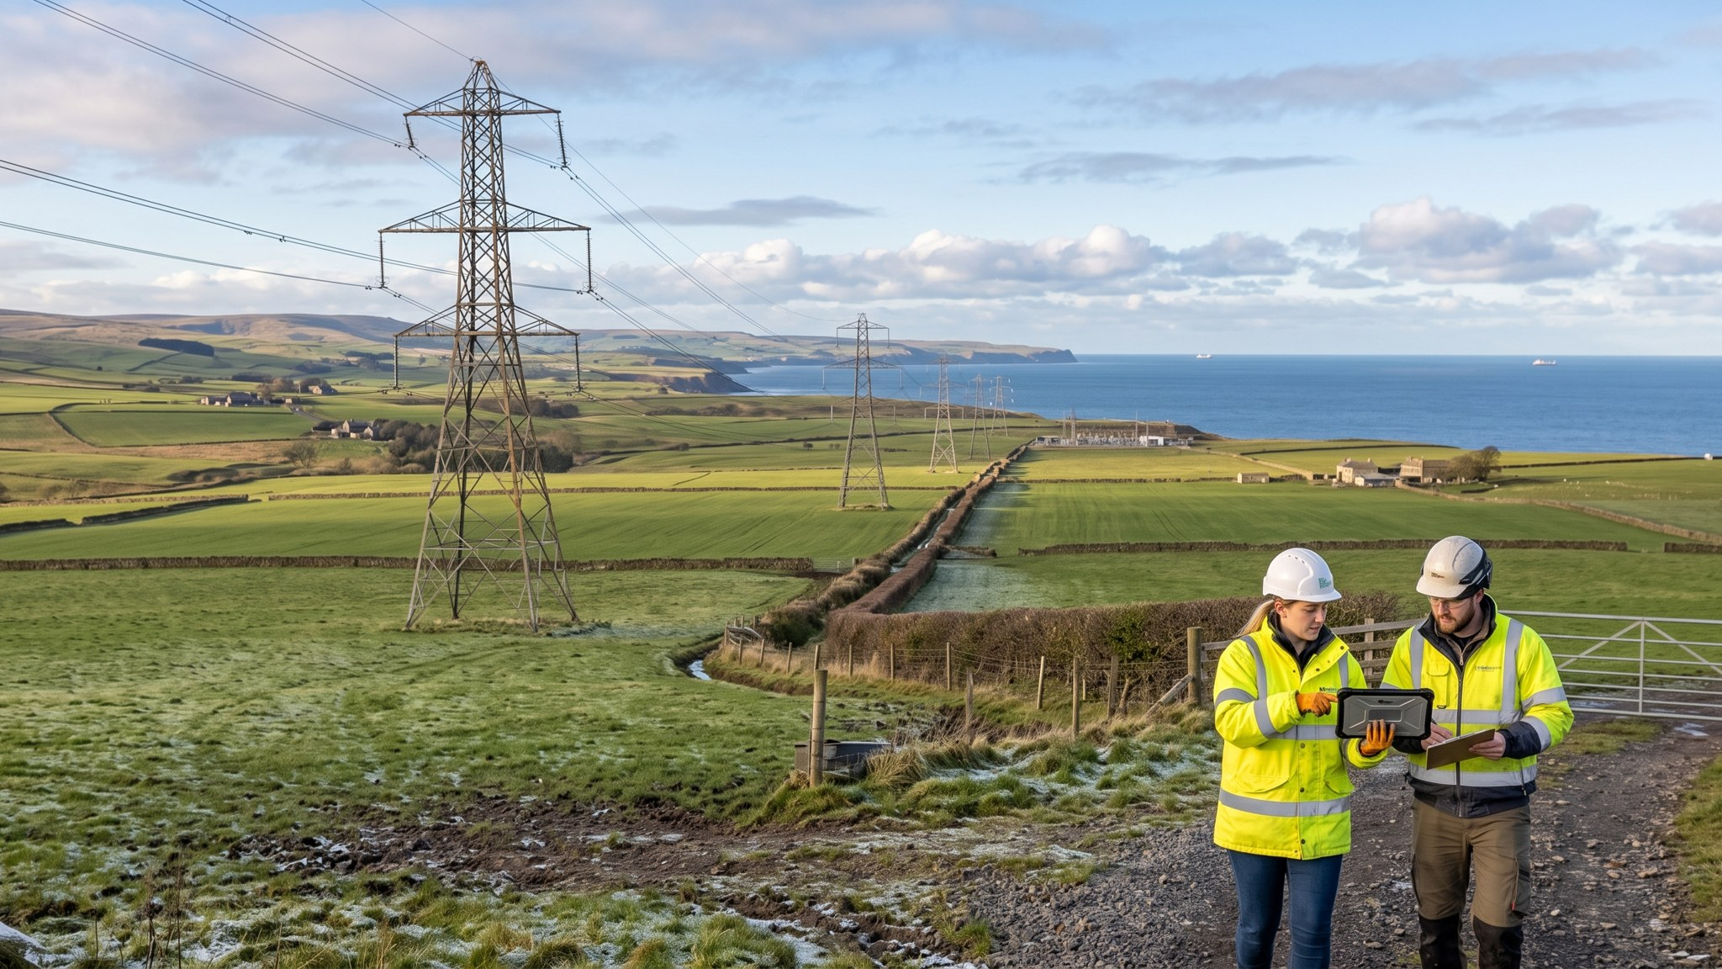
WEYLAND ENERGY
Thank you
Sofie Lindqvist · Ahmed Rahimi · Charlotte Dubois

